Slide 1



UL Technology Solutions
DETECTING FATIGUE FROM
FACIAL LANDMARKS
PRESENTED TO
SUMESH RAJ
PRESENTED BY
ADITYA SASIKUMAR

Slide 2
CONTENTS
INTRODUCTION
PROBLEM IDENTIFICATION
SYSTEM ARCHITECTURE
DATA OVERVIEW
REALTIME WEBCAM DETECTION SYSTEM
DRIVER DROWSINESS DETECTION SYSTEM
PAST BEHAVIOR TRENDS DASHBOARD
ADVANTAGES OF FATIGUE DETECTION FROM FACIAL LANDMARKS
CHALLENGES
CONCLUSION

Slide 3
INTRODUCTION
Project: Develop a computer vision-based fatigue detection system using facial landmarks
Focus: Detect eye closure, yawning, and head nodding in real time
This project focuses on detecting fatigue through facial landmark analysis using computer
vision and machine learning. By analyzing facial points such as eyes, mouth, and head movements, it
becomes possible to determine fatigue levels with precision.
GOALS:
The project emphasizes ethical and privacy considerations, ensuring user data is handled securely
A key part of the project is addressing challenges such as poor lighting, occlusion, and variable camera conditions through pre-processing and video enhancement.
The project emphasizes ethical and privacy considerations, ensuring user data is handled securely.
OUTCOME: This project will deliver a real-time fatigue detection system that identifies eye blinks, prolonged eye closure, and yawning using facial landmarks. A trained machine learning model and a live webcam module will enable accurate fatigue classification, supported by an alert system to warn users when signs of drowsiness appear.
.

Slide 4
PROBLEM IDENTIFICATION
There is a high risk of accidents and reduced performance in scenarios like driving and online learning because human fatigue (drowsiness, loss of attention) is often not detected early or reliably using traditional manual or sensor-based methods.
Existing systems may not provide real-time, non-intrusive monitoring of fatigue using only a standard camera, creating a need for a vision-based solution that can detect signs such as eye blinks, prolonged eye closure, and yawning from facial landmarks

Slide 5
SYSTEM ARCHITECTURE
Component Overview: The system is designed using a modular, multi-layer architecture that separates video acquisition, landmark processing, fatigue analysis, and user-level interaction.
1.. Data Acquisition (Webcam Stream):
A live webcam feed acts as the continuous data source, supplying real-time frames to the processing module.
Each frame is captured and forwarded to the landmark detection engine without delay to maintain smooth fatigue monitoring.
2. Landmark Detection & Processing (Media Pipe + Python):
Facial Landmark Extraction: Media Pipe Face Mesh identifies precise landmark points around the eyes, mouth, and face contour.
Feature Computation: Eye Aspect Ratio (EAR), Mouth Aspect Ratio (MAR), and blink/yawn metrics are computed from the extracted coordinates.
Pre-processing: Each frame undergoes resizing, normalization, and RGB conversion to ensure accurate landmark tracking.
3. Fatigue Analysis Engine (ML + Rule-Based Logic):
Blink & Eye-Closure Detection: EAR-based logic identifies prolonged eye closure and frequent blinking patterns.
Yawn Detection: MAR thresholds detect mouth opening duration and frequency.
Fatigue Classification: A hybrid logic (thresholds + optional ML model) classifies the user into normal or fatigued states.
Alert Triggering: When fatigue conditions persist, an alert event is generated for downstream components.
4. Frontend Interface (Dashboard / Live Preview):
A user-friendly interface displays the webcam output with landmarks, EAR/MAR values, and fatigue alerts.
Interactive charts and indicators help users or operators monitor real-time fatigue patterns.
Supports additional features such as blink counters, fatigue warnings, and visual overlays.
5. Alert & Deployment Layer (Audio/Visual + Optional Extensions):
Real-Time Alerts: Audio alarms or on-screen warnings notify the user during fatigue episodes.
Modular Deployment: The system can be extended for mobile, vehicle dashboards, or browser-based Streamlit applications.
Scalability: The architecture supports integration with logging modules, cloud dashboards, or hardware devices if required.

Slide 6
DATA OVERVIEW
The project utilizes publicly available datasets related to facial landmark-based fatigue detection, including yawning samples, closed-eye images, and facial key-point datasets. Sourced from Kaggle
The key data components include:
• Facial Landmark Coordinates – numerical landmark points around the eyes, mouth, and facial structure.
• Eye State Labels – classification tags such as open, closed, or blinking.
• Mouth Activity Labels – used for identifying yawning patterns.
• Frame-Level Metadata – timestamps and image/frame indices for sequence tracking.
Dataset Frequency:
Data samples are typically extracted from continuous video feeds and stored frame-by-frame, enabling temporal analysis such as blink rate and eye closure duration.
Handling Missing & Noisy Data:
Techniques such as interpolation, filtering, and face-tracking validation are applied to prevent incorrect fatigue detection due to lost facial landmarks or tracking errors.
Data Integrity Notes:
Some samples may include lighting variation, head movement, or partial occlusion, requiring preprocessing to maintain consistency and model accuracy.

Slide 7
REALTIME WEBCAM DETECTION SYSTEM
Objective: To continuously monitor the user in real time and detect signs of fatigue by analyzing facial movements such as blinking patterns, prolonged eye closure, and yawning behavior using a webcam feed.
Method Applied:
The system uses MediaPipe FaceMesh to track facial landmarks in every video frame and extract eye and mouth-related coordinates.
Key metrics such as Eye Aspect Ratio (EAR) and Mouth Aspect Ratio (MAR) are calculated to determine blinking frequency, eye-closure duration, and yawning patterns
Model Applied: Rule-Based Classification with Facial Landmark Tracking
Uses MediaPipe FaceMesh to extract facial landmark points around the eyes and mouth.
Detects fatigue indicators using computed metrics such as Eye Aspect Ratio (EAR) and Mouth Aspect Ratio (MAR).
A rule-driven logic evaluates temporal patterns (e.g., how long eyes remain closed or how long a yawn lasts) to classify fatigue levels.
Model:
Lightweight, real-time detection model optimized for continuous frame processing.
EAR-based logic detects eye closure and blink frequency.
MAR-based logic identifies yawning behavior.
The system transitions between states such as Normal → Warning → Fatigued based on threshold values and time duration
.

Slide 8
Process:
Vs code is the ide used in this app, with the help of streamlit & also there is a past behaviour trends dashboard with days and fatigue data, yawn alarm eyeblink alarm etc.
Frame Capture: Webcam stream is continuously read in real time.
Landmark Detection: MediaPipe extracts face points per frame.
Feature Extraction: EAR, MAR, blink count, and eye-closure time are computed.
Decision Logic: System analyzes short-term and long-term trends for fatigue.
Feedback: UI updates metrics live and triggers visual/audio alerts if fatigue is detected.
Input Features:
Eye Aspect Ratio (EAR): Measures eyelid distance to detect blinking and prolonged eye closure.
Mouth Aspect Ratio (MAR): Identifies yawning intensity and duration.
Blink Frequency: Number of blinks within a defined time window.
Timing Metrics: Duration of closed eyes and yawn intervals to determine fatigue severity.
t

Slide 9
MODELS USED AND ITS PURPOSE:
1. lfbmodel.yaml (Configuration/Architecture)
Purpose: This is likely a Landmark Feature Boundary configuration file.
Role: In facial tracking, .yaml files are often used to define the settings for a model—such as the input image size, the specific facial landmark points to track, or the threshold values for detection. It tells the code how to load and use the model weights.
2. Rf.pipeline (The Decision Maker)
Purpose: This is a Random Forest Pipeline.
Role: Random Forest is an algorithm that uses multiple "decision trees" to reach a single result. A "pipeline" means it doesn't just contain the model, but also the preprocessing steps (like scaling the data or normalizing the EAR values).
In app: It likely takes the raw EAR (Eye Aspect Ratio) and MAR (Mouth Aspect Ratio) numbers and decides: "Based on these 10 frames of data, is the driver actually falling asleep or just blinking?"
3. Eye_blink.pkl (Specific Action Detector)
Purpose: A Pickle file containing a trained model specifically for blinks.
Role: .pkl is a Python-specific format for saving models (usually from the Scikit-learn library). This model has been "taught" what a blink looks like by looking at thousands of examples of closed vs. open eyes.
In app: It outputs a 1 (Blink) or 0 (No Blink).
4. Yawn_model.pkl (Specific Action Detector)
Purpose: A trained model for mouth movements.
Role: Similar to the eye model, this is trained to recognize the specific shape of a yawn. It distinguishes between someone talking or eating versus a deep fatigue-related yawn by analyzing the MAR (Mouth Aspect Ratio).
5. Cnn_model.h5 (The Visual Feature Extractor)
Purpose: A Convolutional Neural Network (CNN) saved in Keras/TensorFlow format.
Role: CNNs are the gold standard for image recognition. While EAR/MAR are simple math formulas, a .h5 model actually "looks" at the pixels of the eye/mouth area to detect complex patterns that math alone might miss.
In app: This is the "heavy lifter." It processes the actual image frames to determine if the eyes are open or closed with high precision.

Slide 10
User Interface & System Output:
The live dashboard displays the webcam feed along with computed metrics including EAR, MAR, blink counter, and fatigue probability.
Visual labels indicate the current detection state — such as "Eyes Open," "Eyes Closed," "Yawn Detected," or "Normal".
A status indicator summarizes the user's condition (e.g., ATTENTIVE, WARNING, or FATIGUED).
When fatigue patterns exceed the defined threshold, the system triggers an audio alert and highlights warnings on screen.
The interface also allows the user to start/stop webcam detection and view historical behavioral trends through charts.

Slide 11
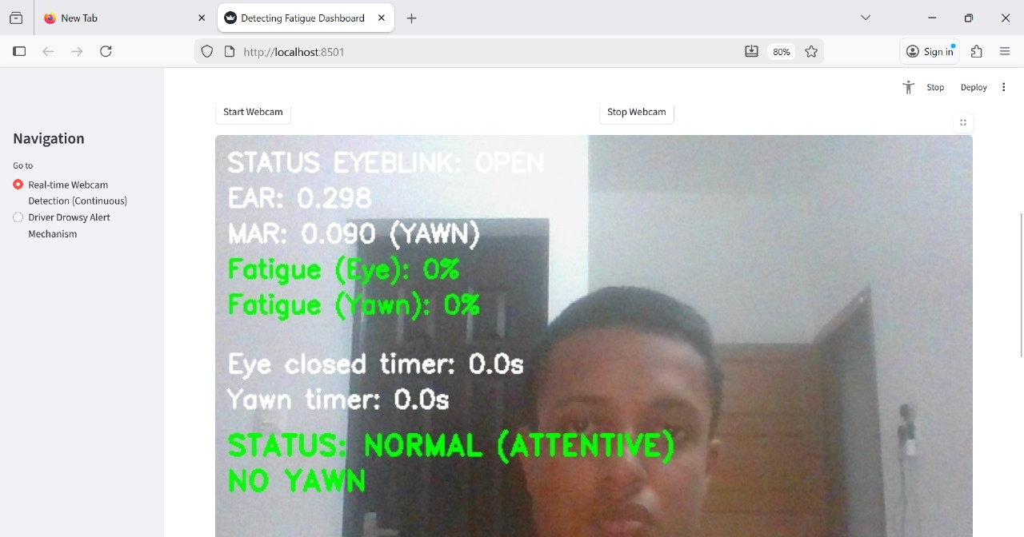
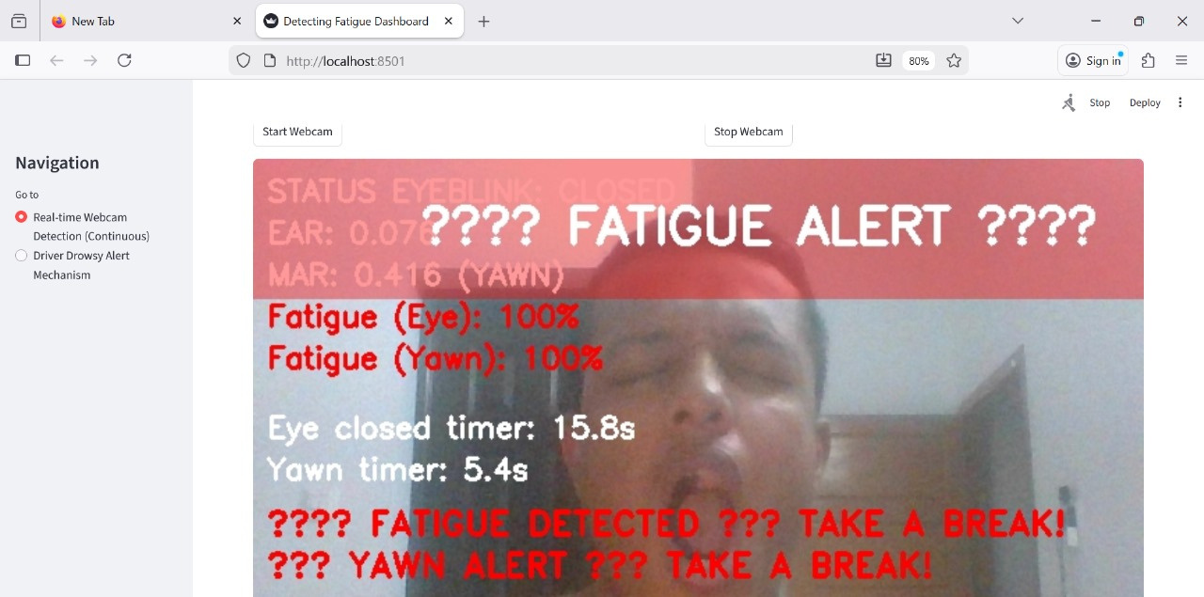
Result
Displays real-time visual overlays such as EAR/MAR values, blink count, and fatigue percentage.
Provides status messages: EYES OPEN, BLINKING, EYES CLOSED, YAWN DETECTED, etc.
A fatigue summary (e.g., NORMAL, WARNING, HIGH FATIGUE) is shown based on detected behavior.
If thresholds are exceeded, the system triggers a fatigue alarm (sound + highlighted warning).
User activity logs can be plotted to analyze long-term behavioral patterns.

Slide 12
DRIVER DROWSINESS DETECTION SYSTEM
Objective:
To develop a real-time computer vision system that can detect driver drowsiness and fatigue by analyzing facial landmarks—specifically focusing on indicators such as eye blink rate, yawning frequency, and eye closure duration.
Model Applied: In this work, a hybrid lightweight ML-powered detection system is deployed.
The system integrates real-time facial landmark extraction (MediaPipe FaceMesh) to compute physiological parameters such as Eye Aspect Ratio (EAR) and Mouth Aspect Ratio (MAR).
These computed EAR & MAR values are classified using pre-trained Machine Learning models stored as .pkl files:
Eye Blink Classification Model (eye_blink_model.pkl)
Yawn Classification Model (yawn_model.pkl)
The models which can be tried out is SVM, KNN, but preferred models is eye_blink.pkl, yawn_model.pkl
Reason for this Model Selection:
Real-Time Performance
Traditional ML classifiers offer extremely low inference latency, making them ideal for real-time fatigue detection in live video streams.
Computational Efficiency
Compared to deep learning models, the selected approach requires minimal CPU/GPU resources, enabling deployment on low-end systems and edge devices.
Optional: The system architecture is modular and supports future extension to temporal learning models.

Slide 13
Model:
Trained on facial features (EAR, MAR, blink/yawn patterns) using open datasets such as YawDD, CEW, and custom webcam footage.
Supports both threshold-based detection and ML classifier outputs for increased reliability.
Designed for adaptability: baseline calibration and online personalization are possible for individual drivers.
Inference logic combines fatigue heuristics (sustained low EAR, high MAR, or head tilt) with classifier probability to minimize false positives.
Input Features:
Core Metrics: Eye Aspect Ratio (EAR), Mouth Aspect Ratio (MAR), blink frequency, yawn duration, and head-pose angles.
Temporal Features: Duration and frequency windows for blinks, yawns, and eye closure (to highlight sustained drowsiness).
Pose Features: 3D head pose for detection of nodding or head tilt events.
Optional: Additional cues like face brightness for low-light adjustment or multi-face support.

Slide 14
Key Hyperparameters:
EAR threshold for eye closure (customizable per user, typically ~0.20–0.25).
MAR threshold for yawning (~0.6–0.75).
Number of consecutive frames to classify a fatigue event (“drowsy” if closed/yawn > N frames).
SVM/RF model parameters: kernel type, tree depth, regularization.
Frame sampling rate (FPS) for real-time balances.
Results:
Achieves robust detection of simulated and real-world drowsiness across benchmark datasets (e.g., CEW, YawDD), as well as webcam and in-car tests.
Real-time performance (25–30 FPS) on typical CPUs; system latency minimal for prompt alerts.
Dashboard interface displays live metrics, triggers visual/audio alarms during detected fatigue, and logs high-risk events for later review.
Extensions enabled: edge deployment on devices like Raspberry Pi; dashboard support via Streamlit/Flask; and advanced privacy settings for on-device only operation.

Slide 15
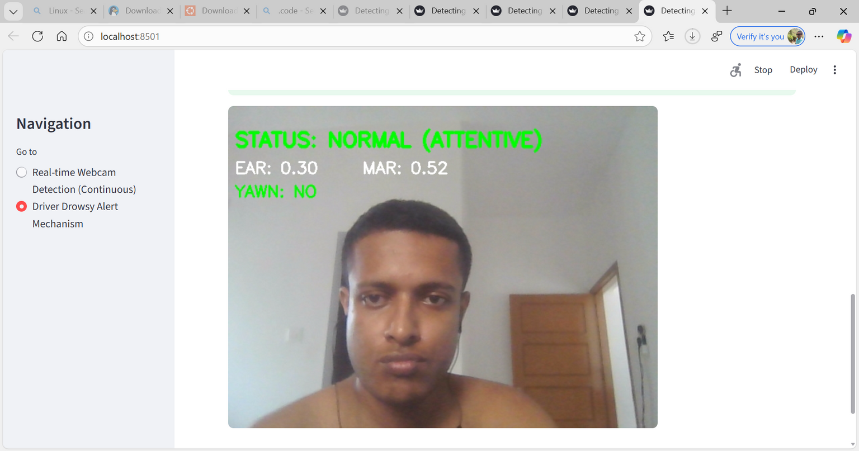
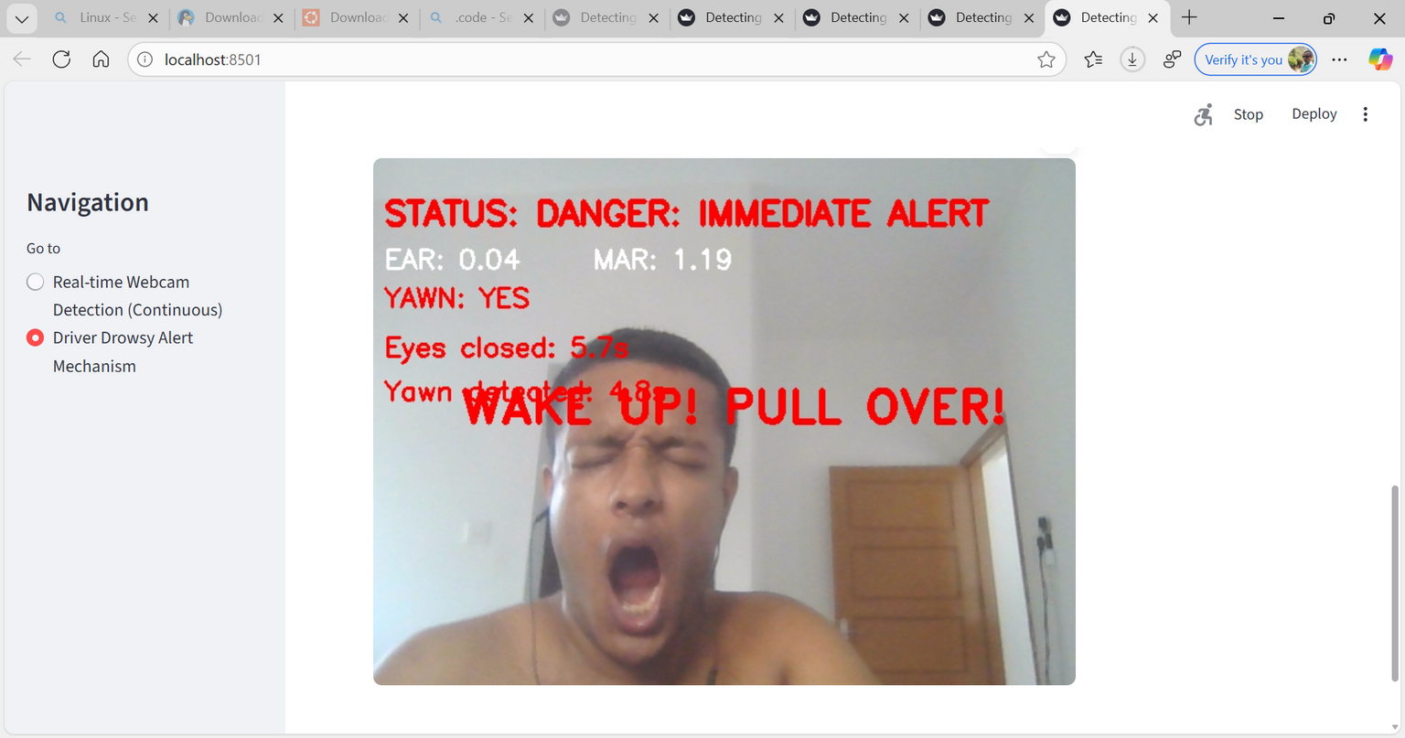
RESULTS:

Slide 16
PAST BEHAVIOR TRENDS DASHBOARD
Purpose:
To visualize historical fatigue-related activity patterns such as blinking, eye-closure duration, and yawning frequency over days or months, helping track how user alertness changes over time.
Graph View (Top Plot):
Displays stacked bar charts showing different fatigue-related events such as:
Eye Closed
Eye Closed Alarm
Eye Open
Yawn Alarm
Yawn Warning
Each color represents a different behavioral state, making it easier to compare fatigue signals across days.
Helps identify fatigue spikes, sleepiness patterns, or irregular behavior
during specific dates or times.
Outcome: The dashboard provides both visual and data-driven feedback,
enabling users to monitor their fatigue patterns over time, detect risky
behavior trends, a downloadable option is available so that the past
trends data can be downloaded, and evaluate alertness improvement
or decline.

Slide 17
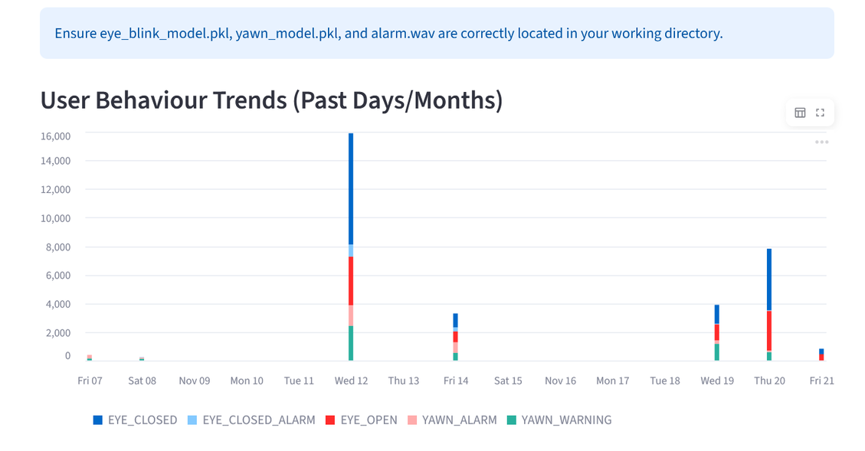
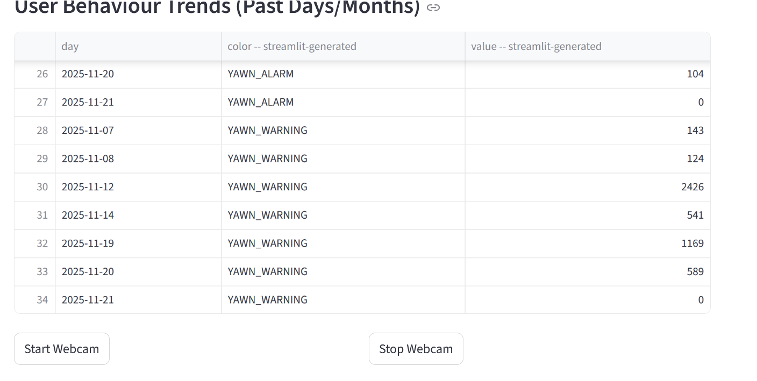
RESULT:

Slide 18
ADVANTAGES OF FATIGUE DETECTION FROM FACIAL LANDMARKS
Fatigue detection using facial landmarks is a computer vision approach that identifies tiredness by analyzing eye and mouth movements captured from a live video stream.
The method relies on metrics like the Eye Aspect Ratio (EAR) and Mouth Aspect Ratio (MAR) to detect prolonged eye closure, blinking patterns, and yawning frequency.
Using rule-based logic or machine learning, the system evaluates these extracted patterns over time to determine whether the user is alert or fatigued.
The results are displayed through a real-time interface, providing visual indicators and alerts to warn users when signs of fatigue are detected.

Slide 19
CHALLENGES
Landmark Detection Stability: Accuracy may drop due to lighting changes, head movement, camera quality, or partial face visibility.
Human Behaviour Variability: Blinking patterns, yawning duration, and fatigue expressions differ across users, making fixed thresholds less reliable.
False Positives and Environmental Noise: Background motion, low frame rate, or poor tracking may trigger incorrect fatigue alerts or delay true detections.

Slide 20
CONCLUSION
Project Outcome: The system successfully detects fatigue in real time by analyzing facial landmarks such as eye aspect ratio and mouth aspect ratio, demonstrating that a standard webcam can be used for non-intrusive monitoring of drowsiness and loss of attention in drivers or students.
Technical Contribution: By combining facial landmark extraction with rule-based thresholds and machine learning models, the project delivers a modular pipeline that can classify blinks and yawns, trigger alerts, and be extended into full applications like dashboards or safety assistants.
Future Scope: The current prototype can be enhanced with adaptive thresholds, deep learning models, head-pose estimation, low-light handling, and deployment on edge or mobile devices to make fatigue detection more robust and widely usable in real-world environments.
End-to-End Fatigue Detection System: The project successfully builds a complete pipeline that detects human fatigue in real time from facial landmarks using a standard webcam input, covering data processing, feature extraction, and detection logic
Practical Safety and Engagement Benefits: By monitoring eye aspect ratio, mouth aspect ratio, and blink/yawn patterns, the system can raise timely alerts for drowsy drivers or inattentive students, helping reduce accident risk and improve attention in real-world scenarios
Provide the current text for the three lines to be reformatted
Should I keep capitalization and line breaks exactly as in the image

Slide 21
THANK YOU

